Slide 1
Disappearing Polar Ice

Slide 2
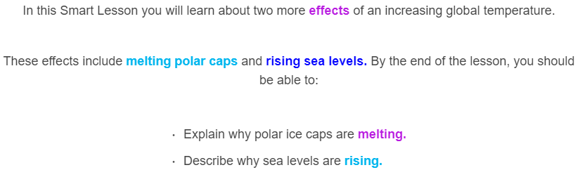
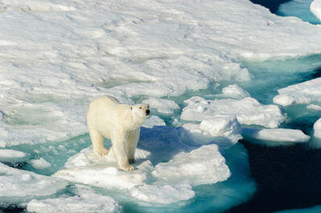

Slide 3
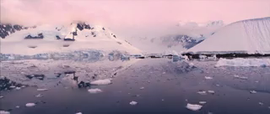
Every year, at each pole, massive ice caps partially melt in summer, then refreeze in winter.

Slide 4
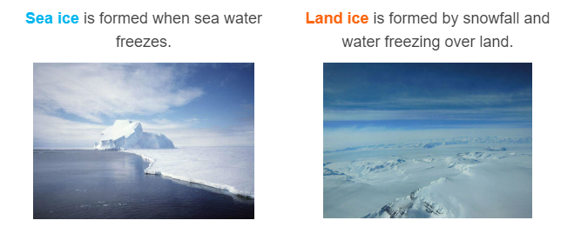
The polar caps consist of sea ice and land ice.
Icebergs are formed when land ice reaches the ocean, and are not an example of sea ice.

Slide 5
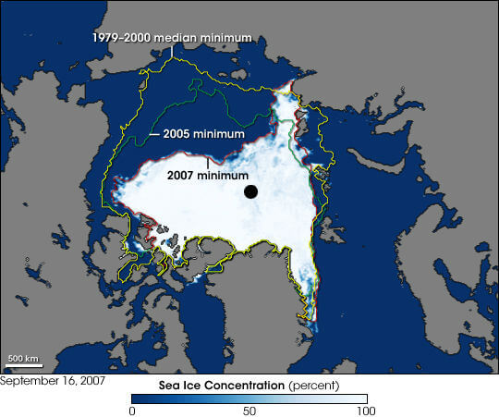
Recently, the polar caps have been melting more in summer and freezing less in winter.
This picture shows the minimum Arctic sea ice (amount of ice left after summer) appears to be getting smaller every year.

Slide 6
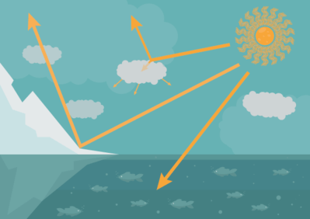
Polar ice acts like a giant mirror, reflecting most of the Sun's rays which land on it, rather than absorbing them. This has a cooling effect, which is lost as the ice melts.

Slide 7
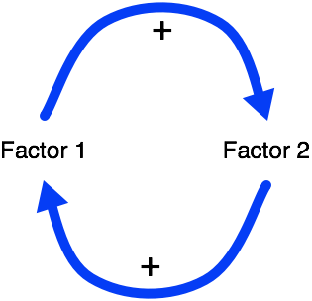
As polar ice melts, more sunlight is absorbed by the oceans, heating the Earth and melting more polar ice caps. This is a positive feedback loop.
A positive feedback loop occurs when two factors enhance each other. In this case factor 1 is melting ice caps, which enhances the global temperature, factor 2, which melts more ice caps.

Slide 8
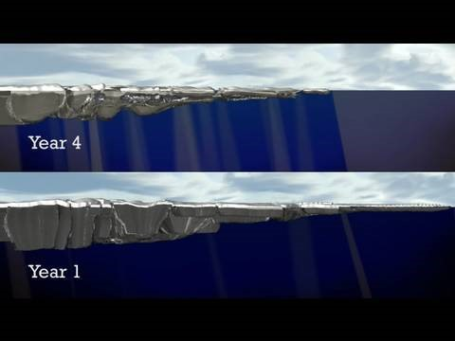

Slide 9
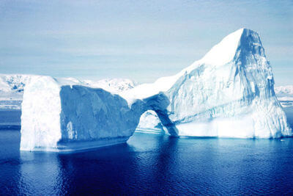
Although sea water is salty, sea ice is made of fresh water. When salt water freezes, the salt remains in the ocean, increasing the salinity and density.

Slide 10
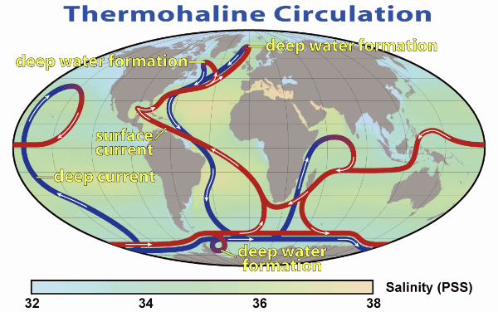
This increase in density is what drives thermohaline circulation (the global conveyer belt). If less ice is formed, there is less dense water and the global conveyer belt could slow and eventually stop!
This would have significant impact on ocean currents and global climate.

Slide 11
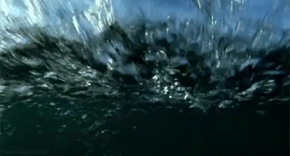
There are two factors that cause sea levels to rise with the temperature:
⋅ | Warm water expands.
⋅ | Melting land ice flows into the oceans.

Slide 12

Water expands as it gets warmer.
This is known as thermal expansion. Thermal expansion is the reason that cold water is denser than warm water.

Slide 13
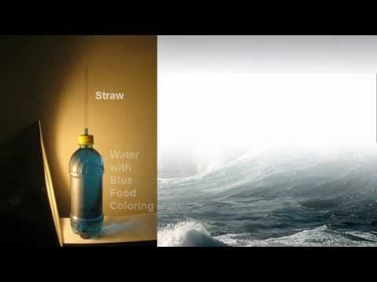

Slide 14
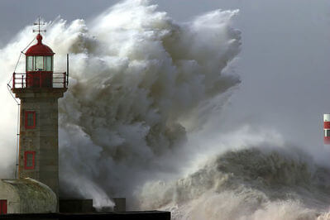
As global temperatures increase, 93% of the heat ends up in our oceans. This causes our oceans to expand slightly, which leads to rising sea levels.

Slide 15
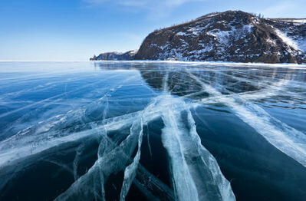
When sea ice melts, sea levels do not change. This is because the ice was floating in the ocean already; the amount of water hasn't changed, only the physical state it is in.

Slide 16
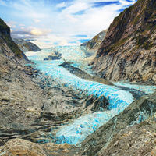
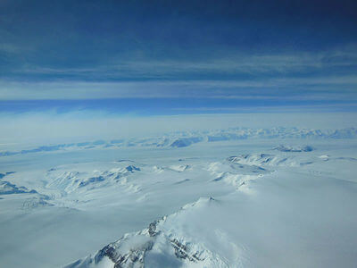
When land ice melts, it flows into the ocean. This increases the amount of water in the oceans and raises sea levels.
The main contributors to land ice are glaciers and ice sheets. Glaciers are massive frozen rivers of ice, such as the one shown on the left.

Slide 17
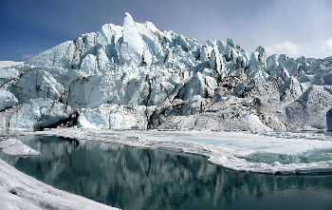
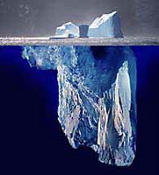
The results are the same, regardless of whether land ice melts on land or in the ocean:
⋅ | As glaciers melt on land, they form rivers of meltwater that flow into the ocean.
⋅ | If a glacier reaches the ocean, the end can break off, forming an iceberg that will eventually melt.
In both cases, water is entering the ocean and increasing the sea level.

Slide 18
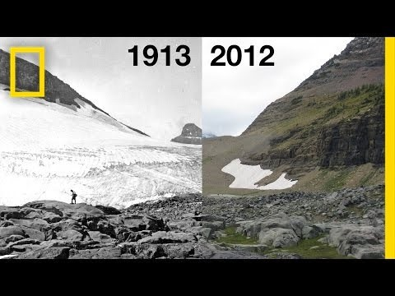

Slide 19
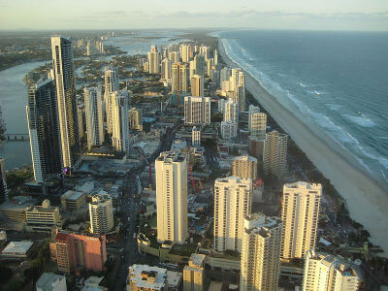
In the past when sea levels rose, animals and humans could move inland until the levels went down again.
Nowadays, a huge amount of our infrastructure is found in coastal cities that cannot be easily moved inland. If sea levels were to rise, the cost to recover would be massive.

